Slide 1
STACK

Slide 2
What is a Stack
The Stack<T> is a Generic collection that stores elements in LIFO style (Last In First Out). C# includes both the Generic Stack<T> and Non-Generic Stack collection classes. It is recommended by Microsoft to use the Generic Stack<T> Collection as it is type-safe and boxing and unboxing it not required.
The Generic Stack in C# is a collection class that works on the principle of Last In First Out (LIFO) and this class is present in System.Collections.Generic namespace. The Generic Stack Collection is used when we need Last In First Out (LIFO) access to items.In Generic Stack Collection, we can store duplicate elements. A Stack can also accept null as a valid value for reference types.

Slide 3
How to Create a Generic Stack<T> Collection
The Generic Collection Stack<T> class in C# provides the following three constructors to create an instance of the Generic Stack<T> class.
Stack(): It is used to initialize a new instance of the Generic Stack class that is empty and has the default initial capacity.
Stack(IEnumerable<T> collection): It is used to initialize a new instance of the Generic Stack class that contains elements copied from the specified collection and has sufficient capacity to accommodate the number of elements copied. Here, the parameters collection specifies the collection to copy elements from. If the collection is null, then it will throw ArgumentNullException.
Stack(int capacity): It is used to initialize a new instance of the Generic Stack class that is empty and has the specified initial capacity or the default initial capacity, whichever is greater. Here, the parameter capacity specifies the initial number of elements that the Stack can contain. If capacity is less than zero, then it will throw ArgumentOutOfRangeException.

Slide 4
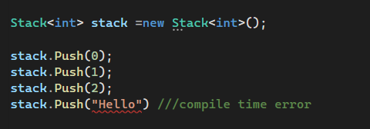
Creating /Adding to a stack
If you want to add elements to a generic stack collection in C#, then you need to use the following Push() method of the Stack<T> class.
Push(T item): The Push(T item) method is used to insert an element on top of the Stack. Here, the parameter item specifies the element to push onto the Stack. The value can be null for a reference type i.e. when T is a reference type, then we can push null to the stack.
NB: We cannot add elements into a Stack using Collection Initializer and the reason for this is the Generic Stack<T> Collection Class does not have an Add method. So, the point that you need to remember is if any collection class does not have the Add method then you cannot use Collection Initializer to add elements.

Slide 5
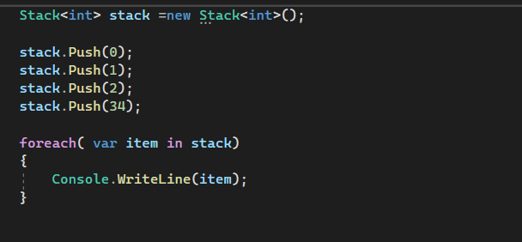

How to access a Generic Stack<T> Collection
We can access all the elements of the Generic Stack<T> collection in C# using a for each loop as follows.
Note: You cannot use a for loop to access the elements of a generic stack collection and the reason for this is the Generic Stack<T> collection class does not have any integer indexer.

Slide 6
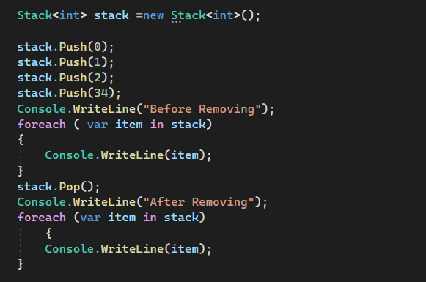
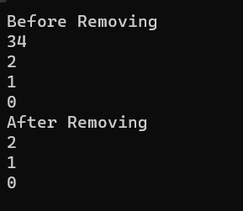
How to Remove Elements from a Generic Stack<T> Collection
In Stack, we are only allowed to remove elements from the top of the stack. The Generic Stack Collection Class in C# provides the following two methods to remove elements.
Pop(): This method is used to remove and return the object at the top of the Generic Stack. It returns the Object (element) removed from the top of the Stack.
Clear(): This method is used to remove all objects from the Generic Stack.

Slide 7
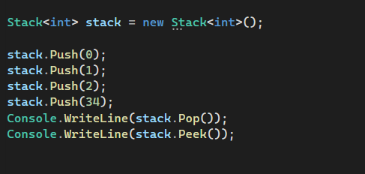

How to get the Topmost Element of a Generic Stack
The Generic Stack class in C# provides the following two methods to get the topmost element of the Stack.
Pop(): This method is used to remove and return the object at the top of the Generic Stack. It returns the Object (element) removed from the top of the Stack. If there is no object (or element) present in the stack and if you are trying to remove an item or object from the stack using the pop() method then it will throw an exception i.e. System.InvalidOperationException
Peek(): This method is used to return the object at the top of the Generic Stack without removing it. If there is no object (or element) present in the stack and if you are trying to return an item (object) from the stack using the peek() method then it will throw an exception i.e. System.InvalidOperationException.
The Pop() method removes and returns the item at the top of the stack, whereas the Peek() method returns the item from the top of the stack, without removing it.

Slide 8
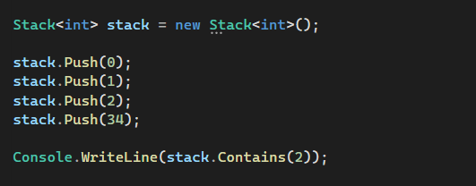

How to check whether an element exists or not in the Generic Stack<T> Collection
If you want to check whether an element exists or not in the Generic Stack<T> Collection, then you need to use the following Contains() method provided by the Generic Stack Class in C#. Even, you can also use this method to search for an element in the given stack.
Contains(T item): The Contains(T item) method is used to determine whether an element exists in the generic stack or not. It returns true if the item is found in the generic Stack; otherwise, false. Here, the parameter item specifies the element to locate in the Stack. The value can be null for a reference type.

Slide 9
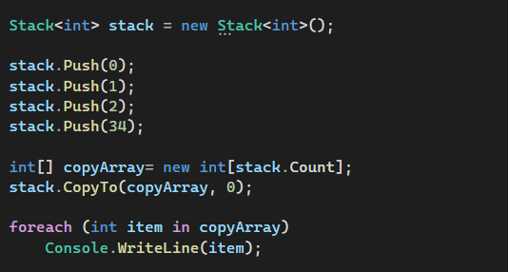
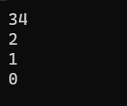
How to copy a Generic Stack to an Existing Array
In order to copy a Generic Stack to an Existing Array in C#, we need to use the following CopyTo method of the Generic Stack Collection Class.
CopyTo(T[] array, int arrayIndex): This method is used to copy the Stack elements to an existing one-dimensional Array, starting at the specified array index. Here, the parameter array specifies the one-dimensional array that is the destination of the elements copied from the generic stack. The Array must have zero-based indexing. The arrayIndex parameter specifies the zero-based index in the array at which copying begins. If the parameter array is null, then it will throw ArgumentNullException. If the parameter index is less than zero, then it will throw ArgumentOutOfRangeException. If the number of elements in the source Generic Stack is greater than the available space from arrayIndex to the end of the destination array, then it will throw ArgumentException.

Slide 10
Generic Stack vs Non-Generic Stack The Generic
Stack<T> Collection Class is defined under System.Collections.Generic namespace where the Non-Generic Stack Collection Class is defined under System.Collections namespace.
The Generic Stack<T> Class in C# can only store the same type of elements whereas the Non-Generic Stack Class can store the same or different types of elements as it operates on the object data type.
In Generic Stack<T>, we need to define the type of elements that we want to store in the stack. On the other hand, in a Non-Generic Stack, there is no need to define the type of elements that we want to store in the stack because it operates on object data type i.e. we can store any type of data.
The Generic Stack<T> is type-safe whereas the Non-Generic Stack is not type-safe. Boxing and Unboxing are not required in Generic Stack whereas Boxing and Unboxing are required in the Non-Generic Stack which will degrade the application performance.
Because of type mismatch, we may get runtime exceptions in a non-generic stack whereas in the case of the generic stack, if we are storing other types of elements, then we will get compile time error.

Slide 11
Generic Stack<T> Collection Class Summary
The Stack Collection is used to store a collection of the same type of elements in a LIFO (Last in, First out) style, i.e., the element which added last will come out first.
As Stack<T> is a Generic Collection, so it comes under System.Collection.Generic namespace.
The Generic Stack<T> Collection stores elements of the specified type. It provides compile-time type checking and doesn’t perform boxing-unboxing because it is generic.
By using the Push() method, we can add elements to a stack collection. Here, we cannot use collection-initializer syntax to add elements to a stack.
The Pop() method will remove and return the topmost element from the stack. It does not support an indexer.
The Peek() method will return the last (top-most) inserted element of the stack, and it won’t delete the element from the stack.
Stack Collection is very useful to store temporary data in the Last In First Out (LIFO) style, where you might want to delete an element after retrieving its value.
New elements are always added at the end of the Stack<T>.
Elements are removed from the end of the Stack<T>
Duplicate elements are allowed to be stored in a Stack.
As a Stack<T> maintains a LIFO collection of objects, so you may use Stack<T> when you need to access the information in reverse order.
To iterate over the elements of Stack<T>, we could use the for each loop

